Slide 1
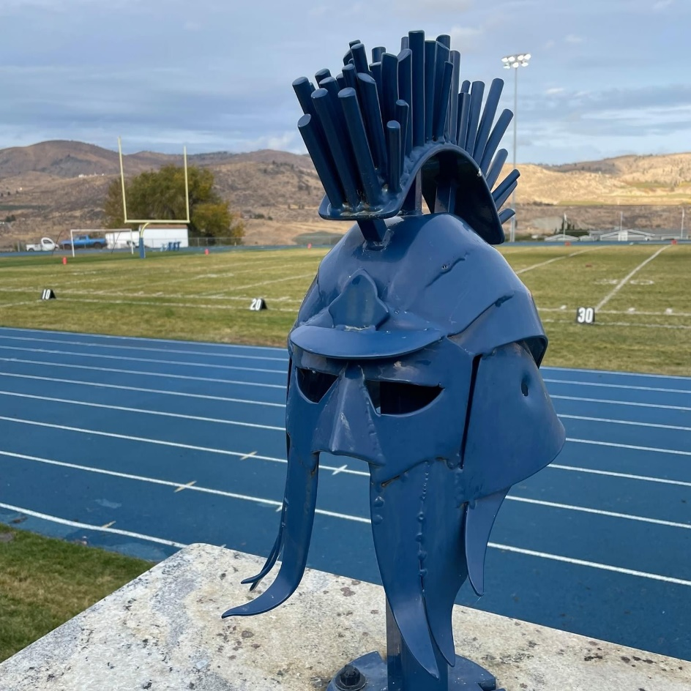
Future Ready: Every Student Ready for Year 13 and Life!
Manson School
District

Slide 2
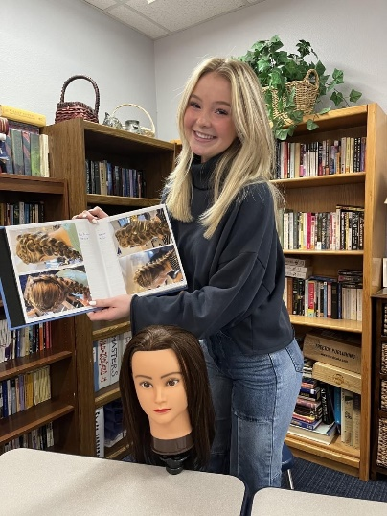
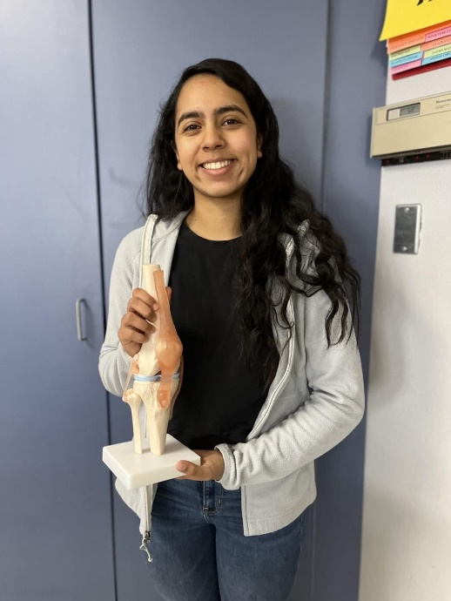
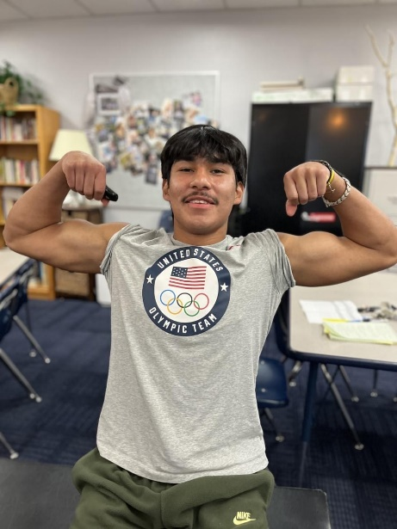
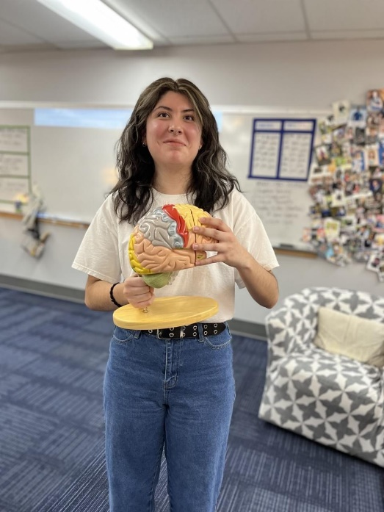
Career &/or College Ready
Preparing Students For “What’s Next”
Student Choice - How and What They Learn
Directed Studies
Integrated Courses
Computer Science - TEALS

Slide 3
DUAL Credits – College in the High School
UW English 111 Composition: Literature, English 131 Composition, Exposition
CWU English 105 Intro to Literature, Math 101 Math in the Modern World, Math 130 Finite Math, Math 153 Pre-Calculus I, Math 154 Pre-Calculus II, Math 172 Calculus I, Math 173 Calculus II, Biology 101 Fundamentals of Biology, Biology 201 Human Physiology, Anthropology 107 Being Human: Past and Present
WVC BCT 105 Computer Applications: Digital Communication, Accounting 102, BCT 251 Web Publishing: Digital Design, Welding 128 Basic Welding
EWU CMST 201 Public Speaking, History 110 The American Experience
BBCC CS 111 Introduction to Programming

Slide 4
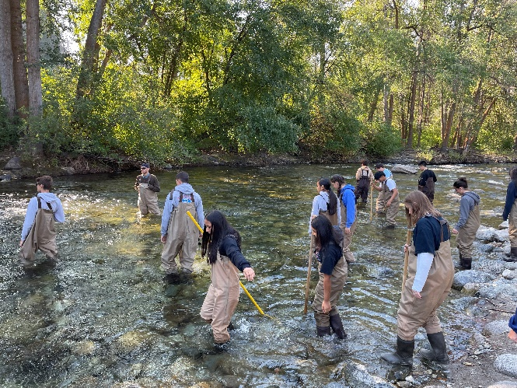
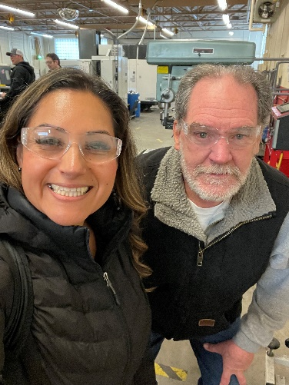
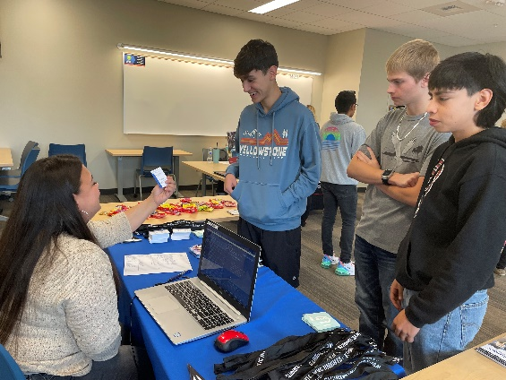
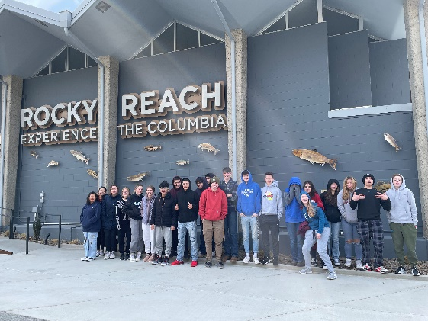
Career Choices (CTE) Course – 1 Trimester – Seniors All Year
Field Trips (WVC Career Fair, Kids in the Creek, WVC/Zara m Academy, Rocky Reach Dam, Colleges with Seniors)
Buzz on Biz (1 Trimester Class)
Networking/Mock Interviews
Mentor/Advising (Manson Strong Time)
STAMP Course
Internship Program Update
86% Seniors in progress or completed
Currently connecting Juniors

Slide 5
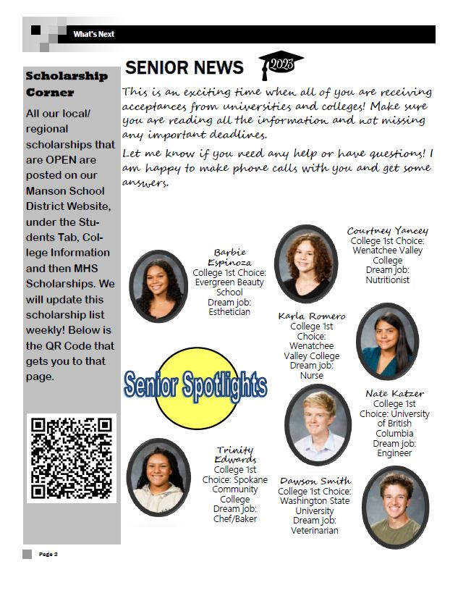
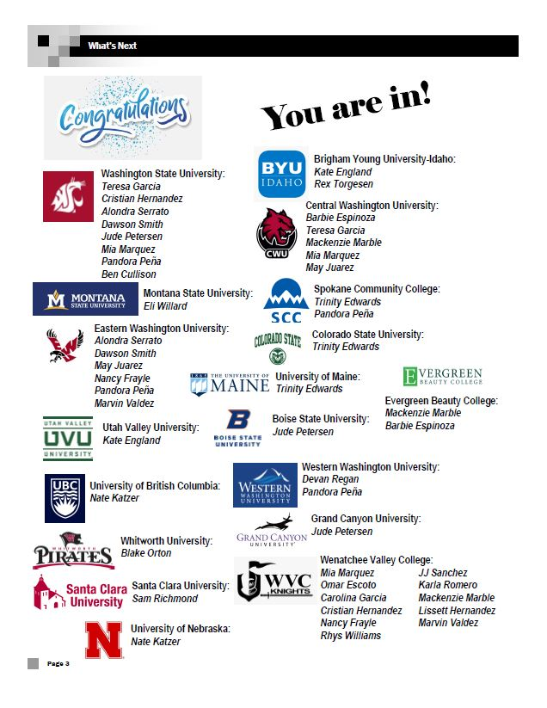
What’s next newsletter

Slide 6
Questions?

